Slide 1

The 2-Hour
WeChat MP
network: Walnut
wifi password: walnut0o0
https://github.com/dengel29/wx-basix

Slide 2
Let’s build it from scratch
https://github.com/dengel29/wx-basix
Notes:
See example of what we’re going to build! Open up landing page from code/one-day

Slide 3
Workshop outline
Theoretical intros
Basic concepts to understand
Live-code demos
I code, you don’t :)
Your turn
Take your time & have fun

Slide 4
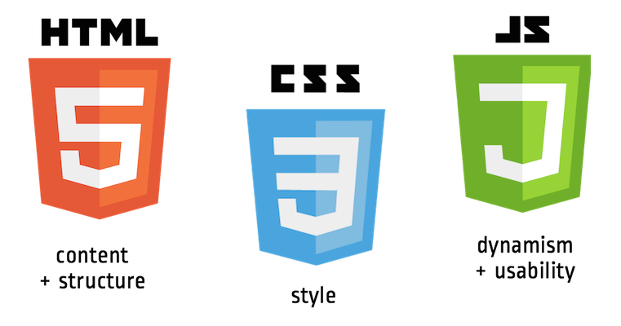
Coding languages

Slide 5
Wx language
WXML
JS
WXSS
X
X

Slide 6
Setup
Download the IDE
http://open.wechat.com/cgi-bin/newreadtemplate?t=overseas_open/docs/mini-programs/development/devtools/download

Slide 7
1. Download the IDE
Notes:
Setup a nice environment to code.
Please stop me if you have any questions!
Landing page folder on desktop
Open Sublime Text.
Drag and drop folder into Sublime.
See architecture of files
Right-click, new file
Command/Control + S – ALWAYS Save your files
Playground.html or index.html
Style.css file
Images Folder
Open folder/file in broswer.
2 minutes to do this!

Slide 8
THE IDE
Starting a new project
Quick tour of your toolkit
What’s inside a boilerplate project

Slide 9
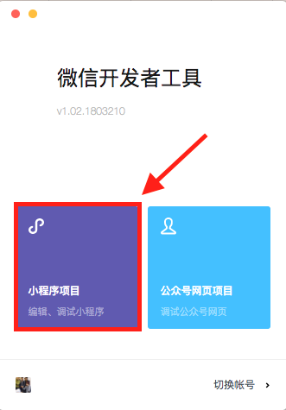
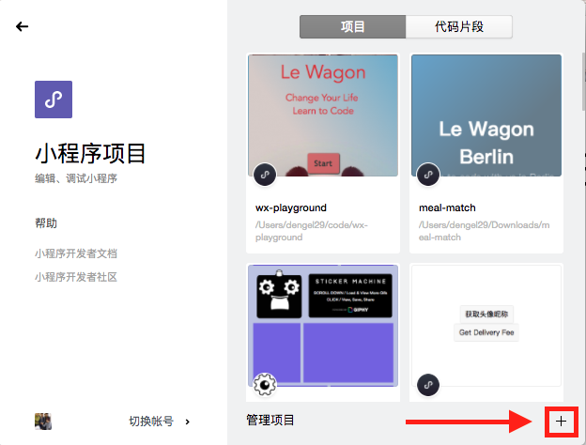
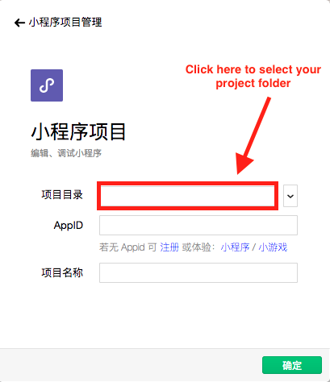
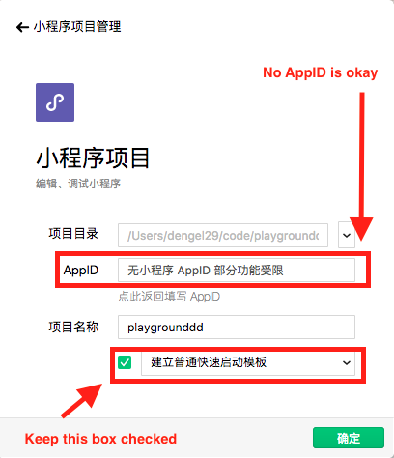
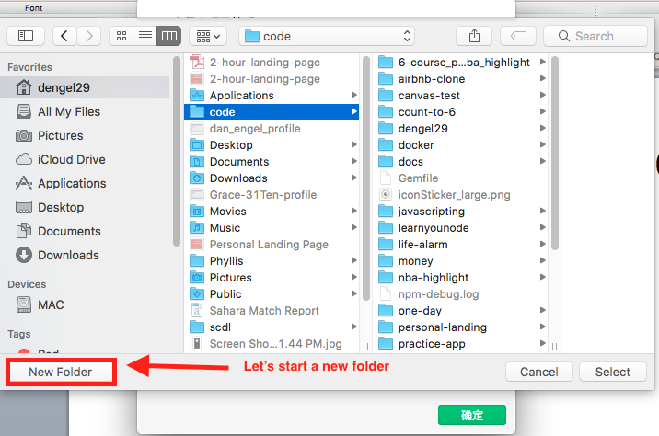
2. Starting a new wx project
1.
2.
3.
4.
5.

Slide 10
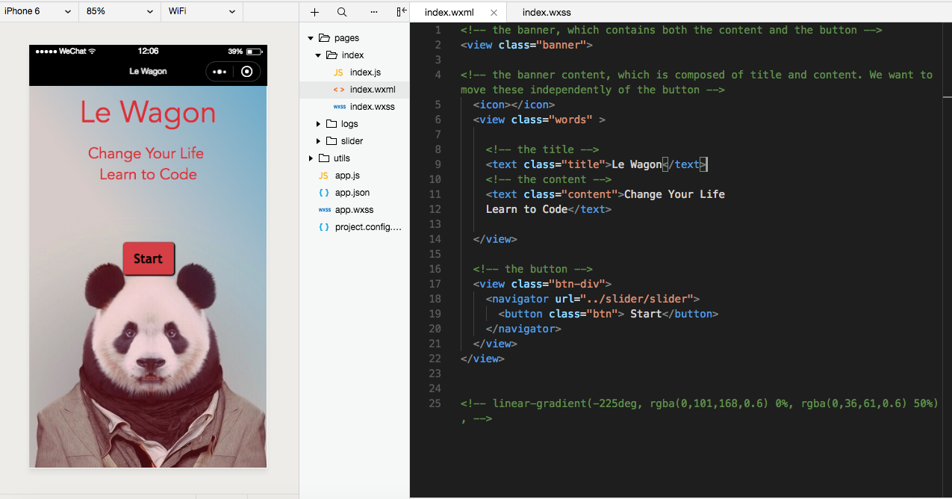
Congrats, you’re in!

Slide 11
Quick Tour of IDE

Slide 12
Your Building Blocks

Slide 13
Structure
WXML
Structure your content
Notes:
Frame of the house

Slide 14
Design
WXSS
Design the colors, size and positioning
Notes:
Wallpaper, colors

Slide 15

Animation
Animate your content
Notes:
Buttons and switches

Slide 16
3. WXML
Without structure or content,
we cannot design

Slide 17
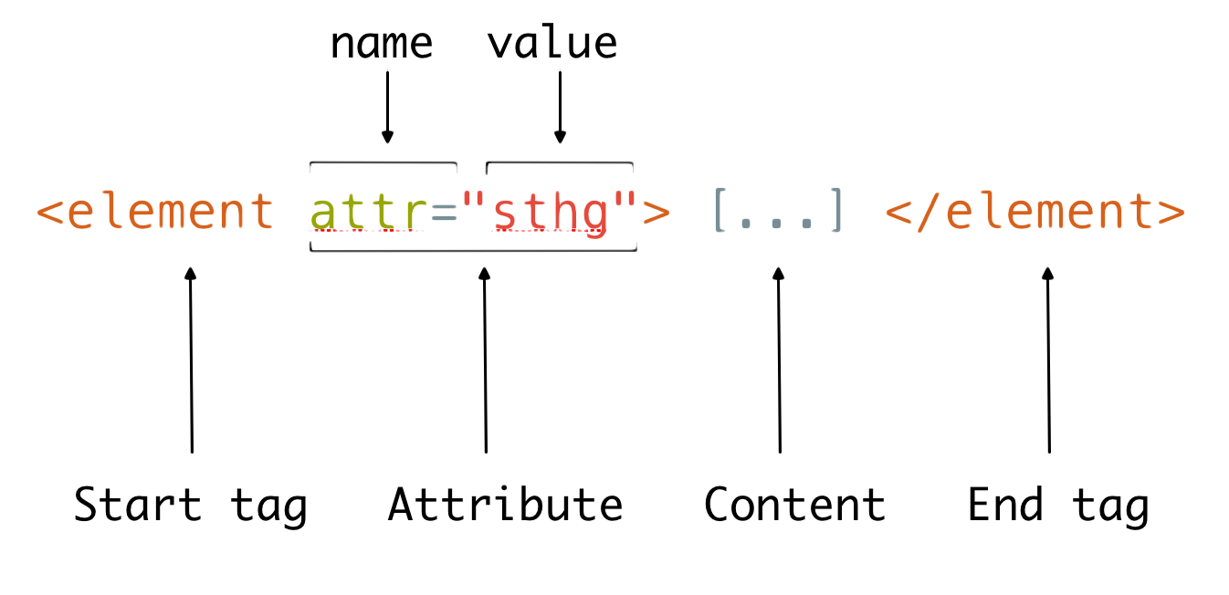
Core syntax
Notes:
Element = h1, h2
Attribute: class, source, href
Conent
End tag

Slide 18
Syntax example
<text>Start!</text>
Start!
What is the tag name?
What is the content?
Are there any attributes?

Slide 19
WXML - text
<text>Big Text</text>
Big Text
Not so big…
…
For different text sizes and styles, we need WXSS
Notes:
Let’s all try together!

Slide 20
Another syntax example
<navigator url="http://lewagon.org">
Le Wagon
</navigator>
What is the tag name?
What is the content?
What is the attribute?
Le Wagon

Slide 21

WXML – image *
<image src="logo.png"></image>
*We can also use WXSS to include images.
Notes:
Add an image!
We have to state the path file though! If it’s in the same folder, just the file name is fine. If it’s in another folder, it gets a little more complicated.

Slide 22
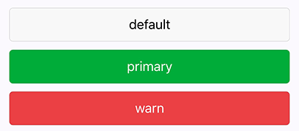
WXML - button
<button type="default">
<button type="primary">
<button type="warn">
More button info
Notes:
Add an image!
We have to state the path file though! If it’s in the same folder, just the file name is fine. If it’s in another folder, it gets a little more complicated.

Slide 23
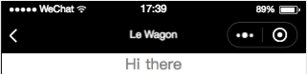
WXML - input
<input placeholder="Hi there"></input>

Slide 24
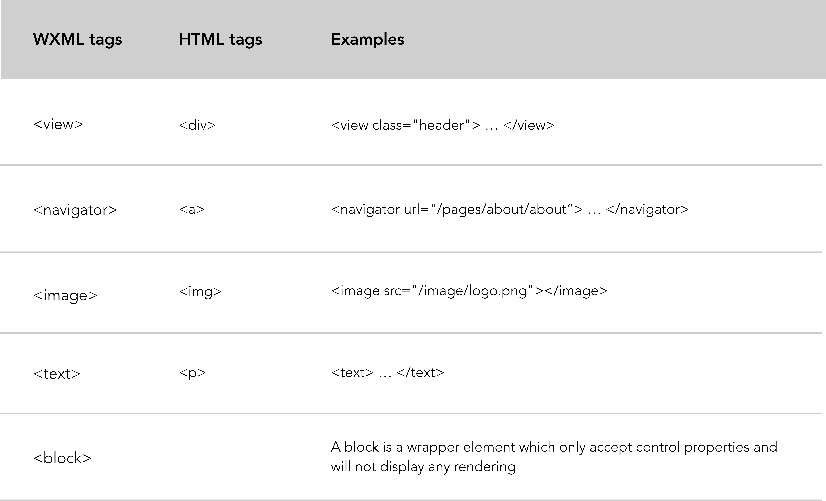
Different content = different tags

Slide 25
Your turn!
3. Let’s build our WXML for the
home page
Notes:
What does it look like?
Img
H1
P
(img+h2+p)*4
What about these icons? And footers? We’ll get to that later
5 mins to try and build it!

Slide 26
What’s the content?
Image
Text (title + subtitle)
Button

Slide 27
Different content = different tags

Slide 28
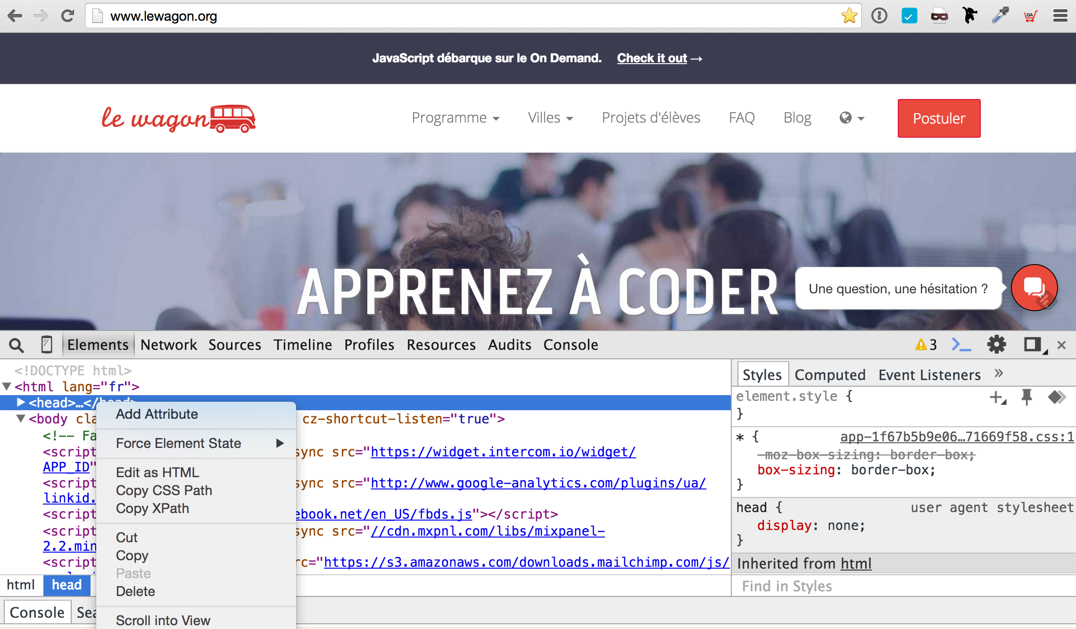
WXSS
What does the web look like
Without CSS WXSS?
Notes:
Who has seen the inspect page before?
Vist lewagon.com/chengdu
What would happen if we cut the head CSS!

Slide 29
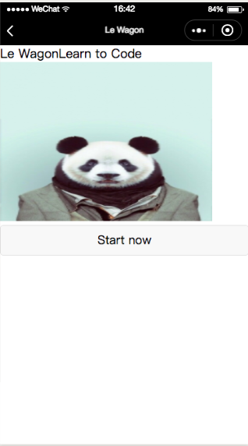
Well, it looks like this
Squashed images
Uniform, ugly text
Boring buttons

Slide 30
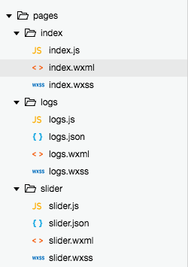
Linked stylesheets
Every page has a .wxss file that will dictate the style in the related .wxml file.
index.wxss
is the stylesheet for
index.wxml
Notes:
<link rel = “stylesheet” href = ”style.css”>

Slide 31
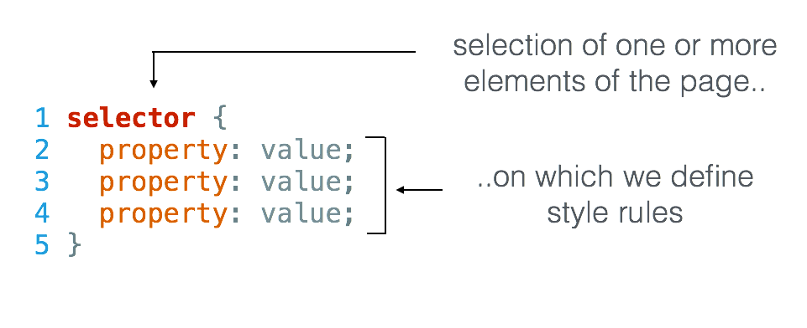
WXSS syntax

Slide 32
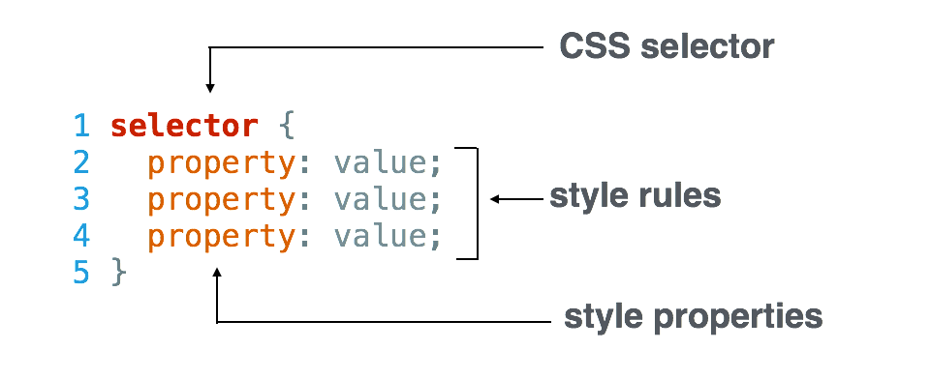
WXSS syntax
Use the good keywords on Google

Slide 33
WXSS example: text
index.wxml
index.wxss
<text>
Big Red Title
</text>
text {
font-size: 48rpx;
color: red;
font-family: Avenir
}
Big Red Title

Slide 34

WXSS example image
index.wxml
index.wxss
<image src=“logo.png”>
</image>
image {
height: 100rpx;
width: 100rpx;
}

Slide 35
Creating Classes
index.wxml
index.wxss
<text class=“title”>
Big Red Title
</text>
<text class=“content”>
Cool blue content
</text>
.title {
font-size: 24rpx;
color: red;
font-family: Avenir
}
.content {
font-size: 24rpx;
color: blue;
font-family: Avenir;
}
Big Red Title
Cool blue content

Slide 36
WXSS for Fonts & Colors
Notes:
Let’s start writing CSS!
First – we have to LINK in our head! The ‘brain’ needs to know where to put the style.
Go to css file – start with
the body, then
H1
a { text-decoration: none; color:blue}
a:hover { text-decoration: none, color:black}
body{ background: green; color: black; font-size: 15px; font-family: Helvetica; margin: 0 auto;}
Coolors.co
Colorhunt.co
SIP color picker
Fonts.google.com
Open Sans, Roboto, Montserrat
Google Fonts header goes BEFORE css.style ref.
Header: Montserrat
H2 – Open Sans

Slide 37

Colors
h2 {
color: orange;
color: #FF530D;
color: rgb(255, 83, 13);
color: rgba(255, 83, 13, 1.0);
}
Notes:
First decision for design is FONT and COLOR SCHEME
RGB – 0 to 255
Red, green, blue
A – transparency – 1 not transparent – 0 totally transparent
Don’t want to go into too much detail since name or color code works fine.

Slide 38
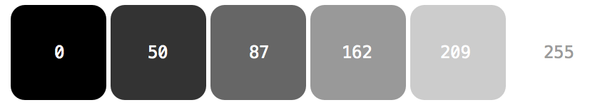
RGB tips
Notes:
Gray scale…best friend in design

Slide 39
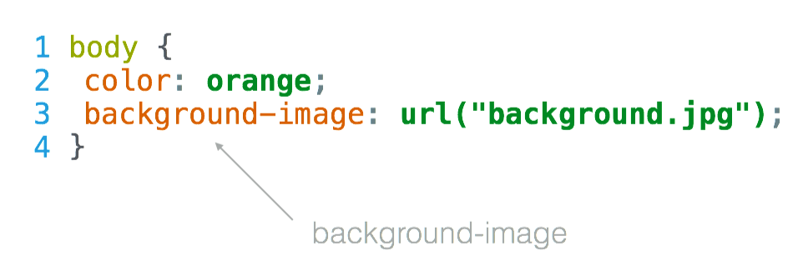
Backgrounds

Slide 40
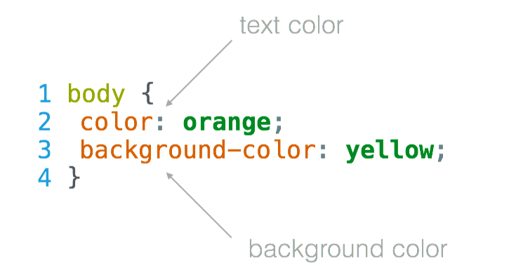
Text vs. Background
Colors

Slide 41
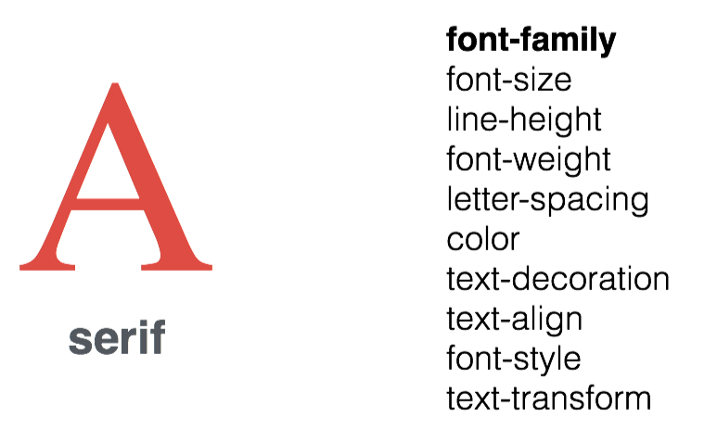
Font family
Notes:
This is what many of you probably just call “fonts” from your experience with Word
https://developer.mozilla.org/en-US/docs/Learn/CSS/Styling_text/Fundamentals

Slide 42
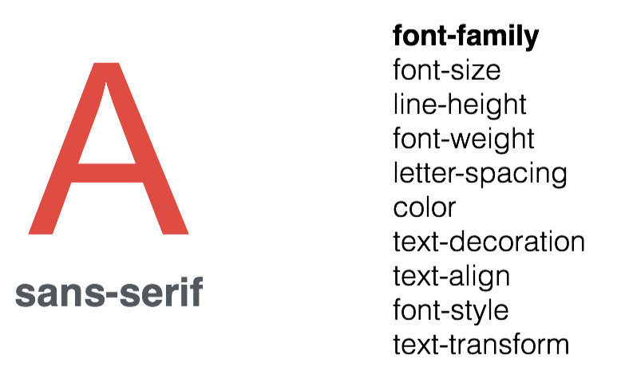
Font family

Slide 43
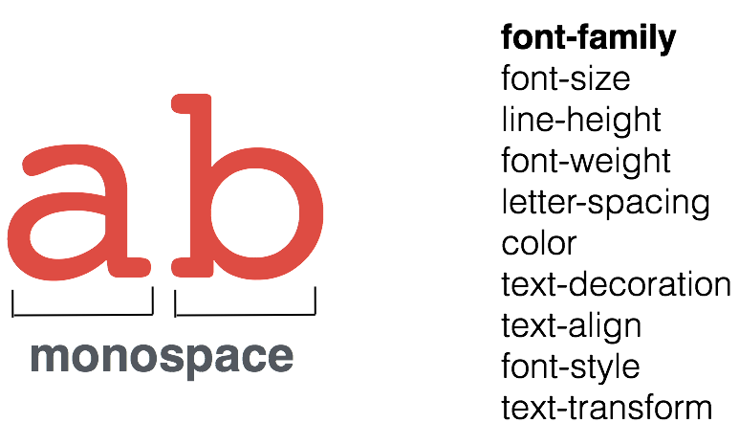
Font family
Notes:
Monospace is one of the basic web fonts available, also serif, sans-serif, cursive, fantasy

Slide 44
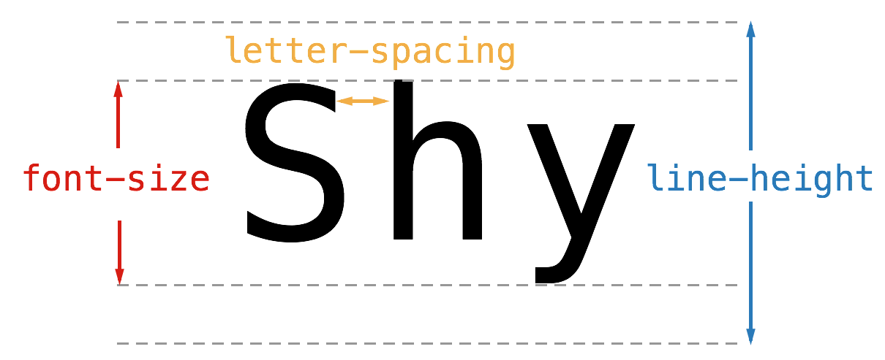
Font size & spacing
Notes:
Line-height – give some ‘breathing room’ to the text so there is space above and below
Font-size will not change with line-height
Letter-spacing

Slide 45
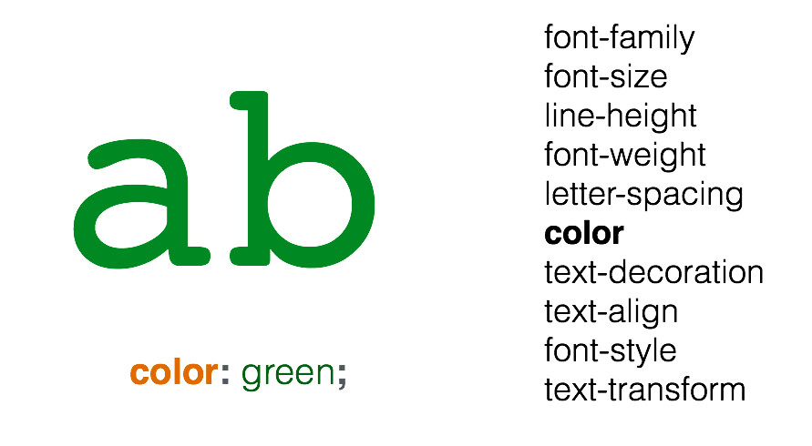
Font color

Slide 46
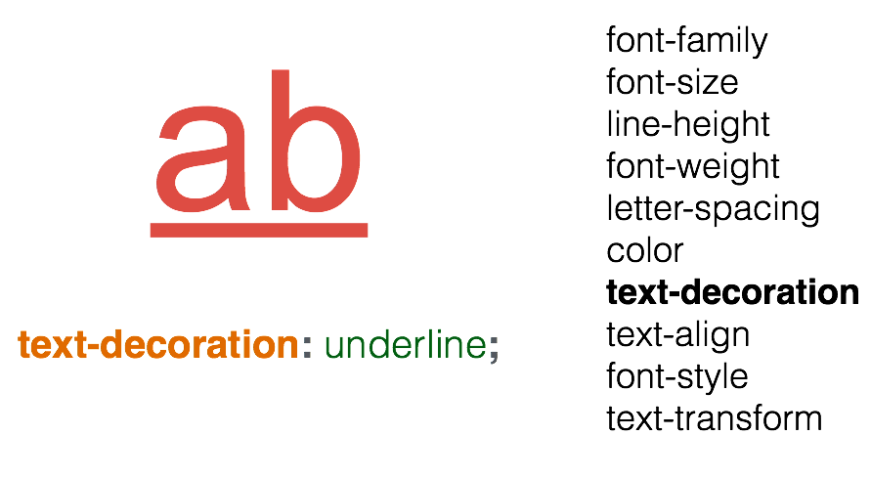
Font decoration
Notes:
Decorators give you things like underlines, strikethrough,
Re-affirm what is “property” and what is “value”
Text-decoration: none

Slide 47
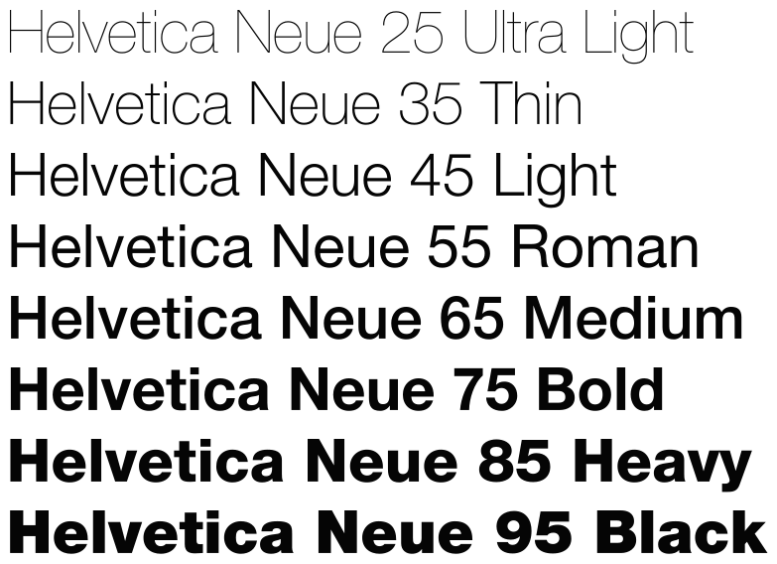
Font weight
Notes:
Weight is the boldness; not just on-off, but values effect it slightly
Google Fonts

Slide 48
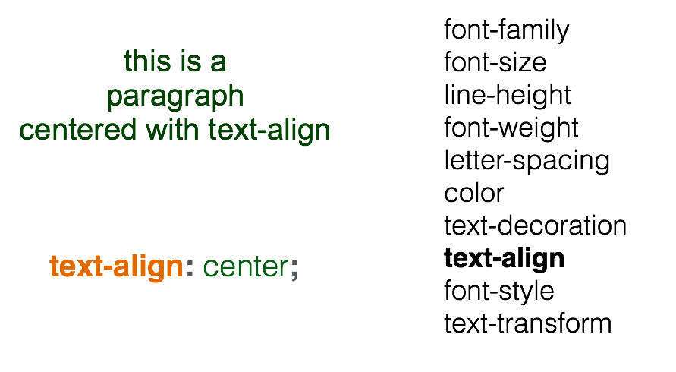
Font alignment

Slide 49
Write some WXSS rules for each class!
4. Your turn!
index.wxml
index.wxss
Add class to your:
1. banner 2. title
3. content 4. button
then

Slide 50
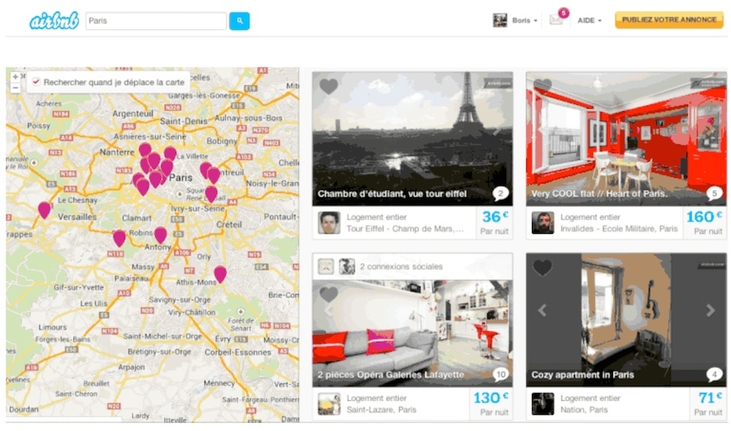
View & Box model
Real-life…
Notes:
Div- divider
Div
Inspect airbnb.com

Slide 51
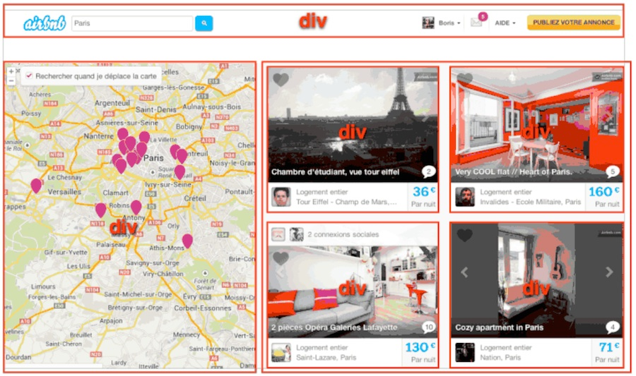
View & Box model
…is made of boxes
Notes:
Divs can have properties –
Margin
Padding ← difference between margin and padding coming up
Width
Height
Border
Border-radius

Slide 52
Wrap an element (or elements) in <view>
<view>
<text class=“big”>Title</text>
<text class=“small”>Subtitle</text>
</view>
You can group them, shape them, position them, move them closer, spread them apart, and much more

Slide 53
How can we see this?
Inspect!

Slide 54
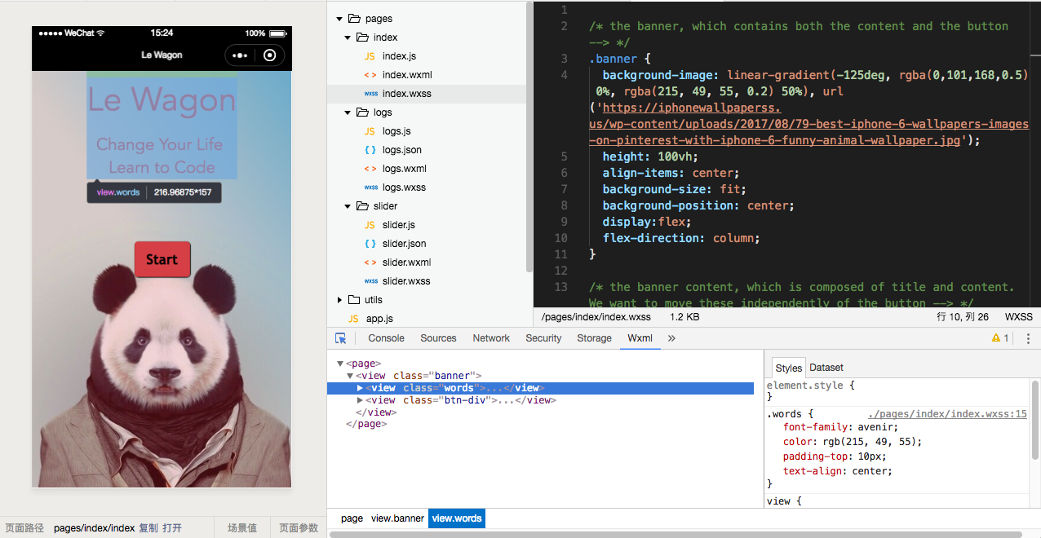
command + shift + i → opens inspector

Slide 55
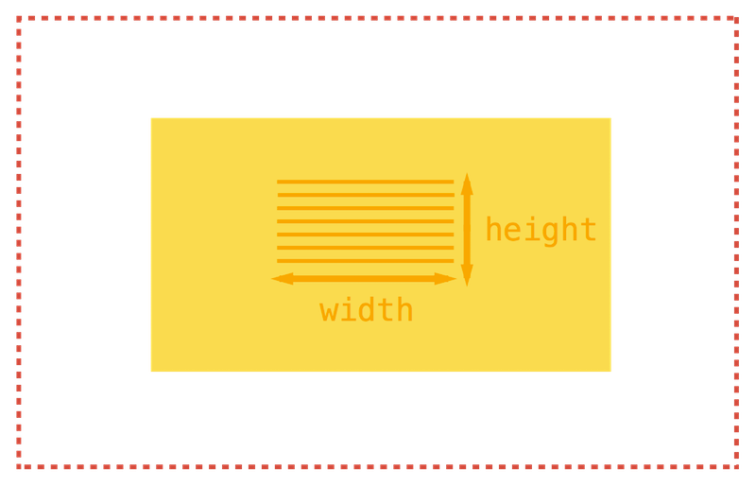
Box model - content
Notes:
Width of the CONTENT of the box
Height of the CONTENT of the box

Slide 56
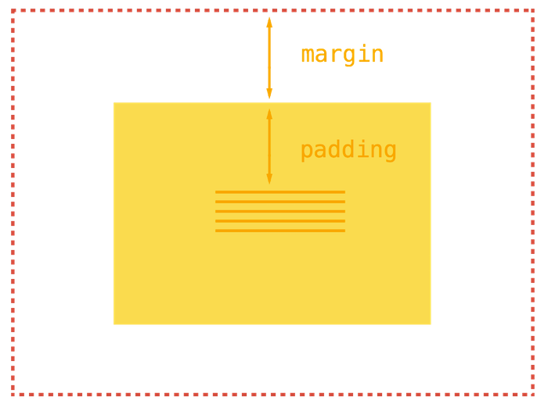
Box model - margins
Notes:
Space in the content of the box – padding – internal space
What is surrounding the box – margin – external margin

Slide 57
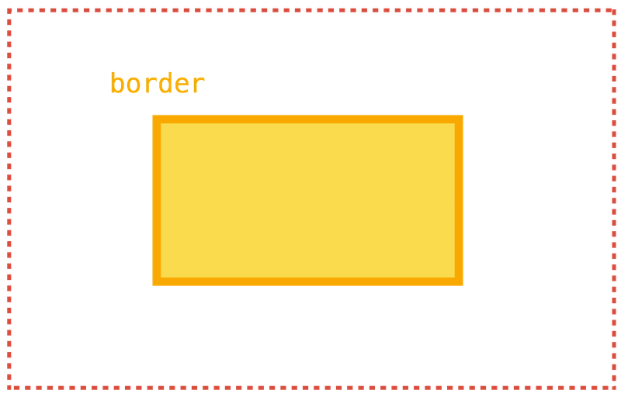
Box model - border
Notes:
Border –
Border-shadow
Border-width – 1, 2, 3px
Border-style – solid, dashed

Slide 58
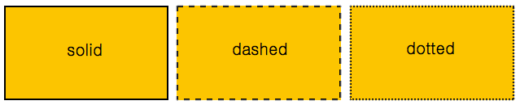
Box model - border
.title {
border: 1px solid green;
border: 2px dashed #FF530D;
}

Slide 59
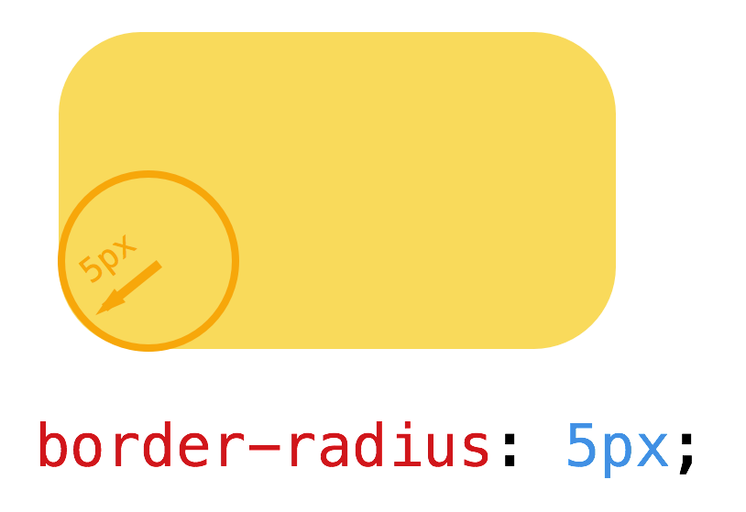
Box model - radius
Notes:
Border-radius: 5px;
50px

Slide 60
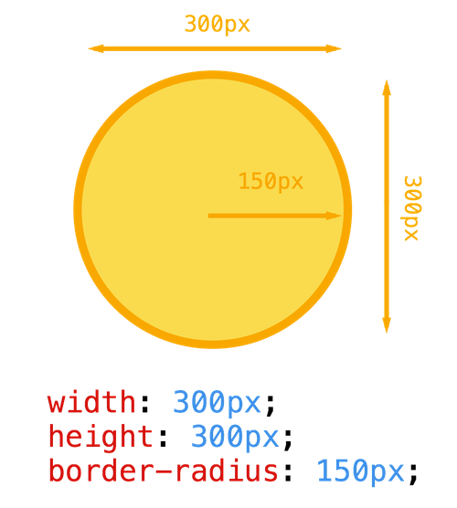
Box model - radius

Slide 61
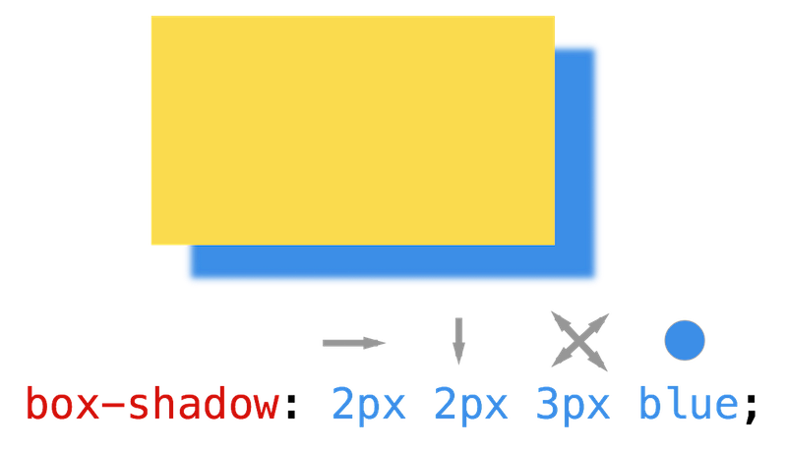
Box model - shadow

Slide 62
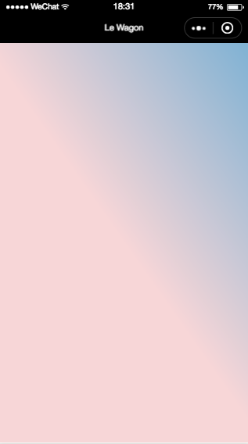
Background Tips
index.wxml
<view class=“body”>
...
</view>
result
index.wxss
.body {
background-image: linear-gradient(-125deg, rgba(0,101,168,0.5) 0%, rgba(215, 49, 55, 0.2) 50%);
height: 100vh
}
More info on linear gradient

Slide 63
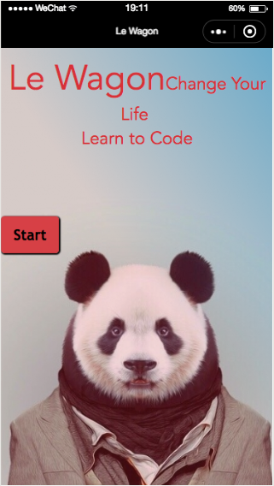
Positioning Elements
Add this wxss to get your elements in line
In a view containing vertical elements you want in a row
display: flex;
flex-direction: column
align-items: center;
In an element you want on a line by itself
display: block;

Slide 64
Your turn!
5. Wrap with view
Notes:
Give every piece of content a div – so that we can play with it later
Play in chrome inspector:
Padding
Margin
Border-radius
Box-shadow: horizontal: 1px vertical 1px blur 3px green;
Shadow tips – small shifts, small hz/vt shifts, small level of blur

Slide 65
id & class
Notes:
https://css-tricks.com/the-difference-between-id-and-class/
Barcodes vs. serial numbers
Information that is reusable should be kept in a class – information/styling that is totally unique should be kept in a id
Regarding CSS, there’s nothing you can do with an ID that you can’t do with a class. However, JS cares.
-each element can have only one ID (remind what is an ‘element’)
-

Slide 66
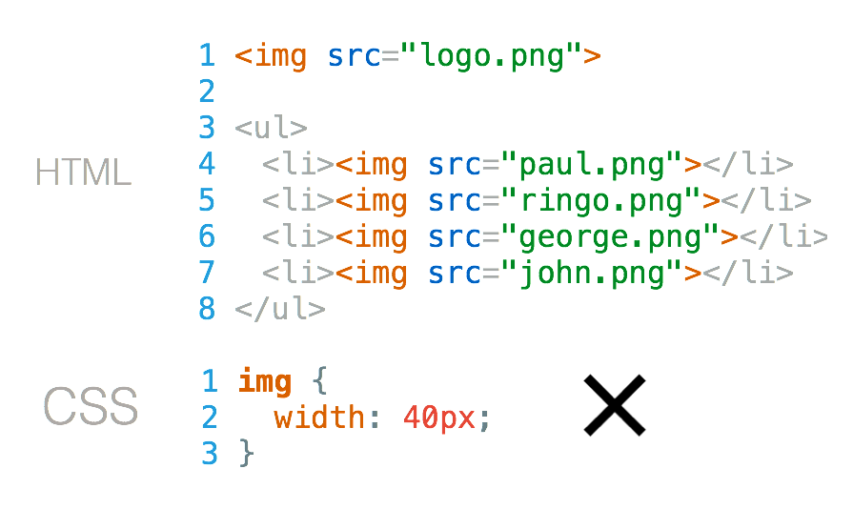
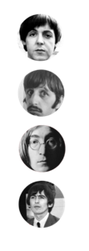
how do you resize the logo only?
Notes:
This is going to change ALL of the IMG tags!

Slide 67
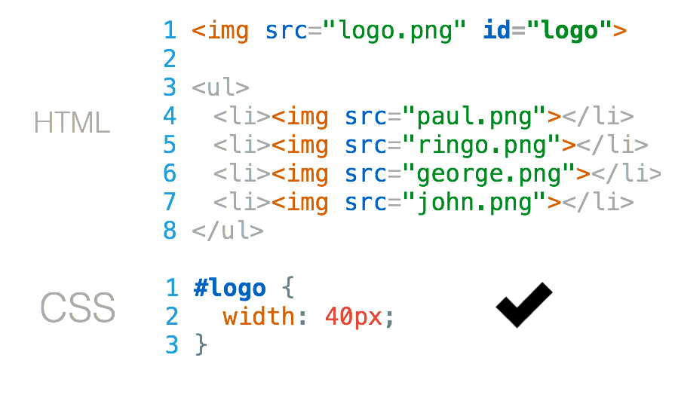
how do you resize the logo only?
Notes:
We have to give it an ID
IDs in CSS are marked with a HASH

Slide 68
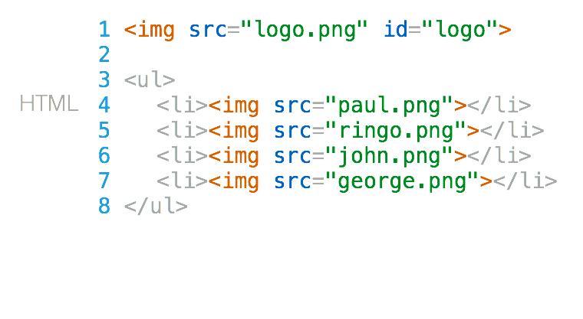
how do you style staff pictures only?

Slide 69
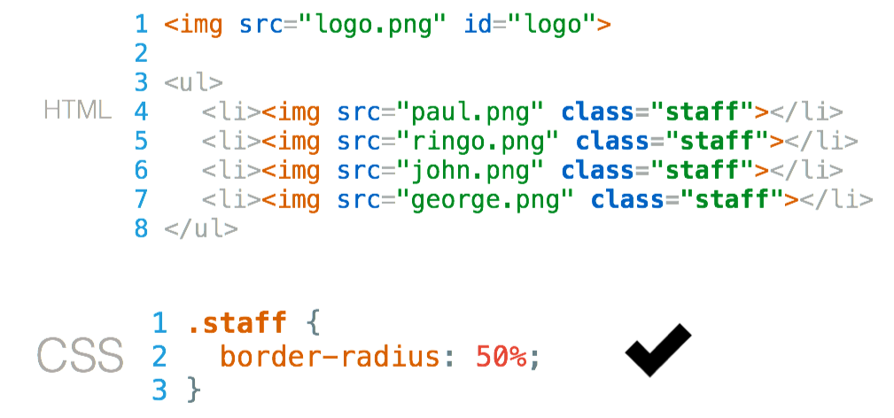
how do you style staff pictures only?
Notes:
Give them a CLASS
Class are marked with a period in CSS
.staff

Slide 70
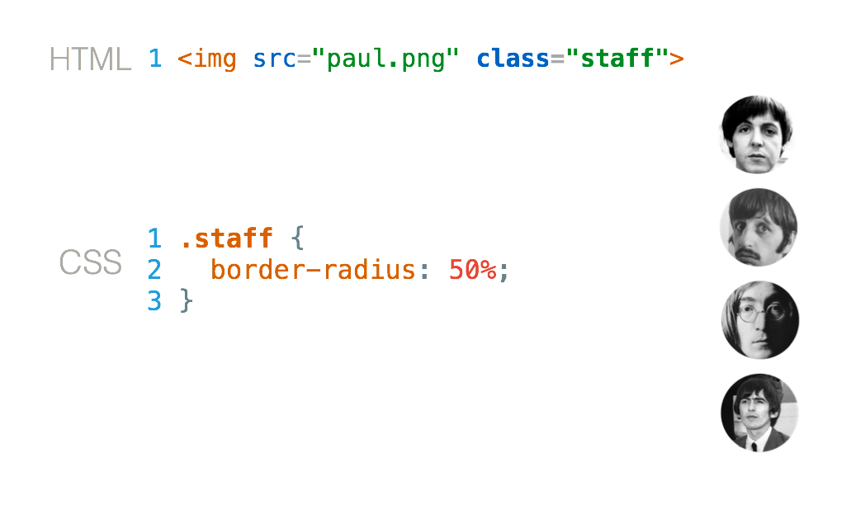
Combine

Slide 71
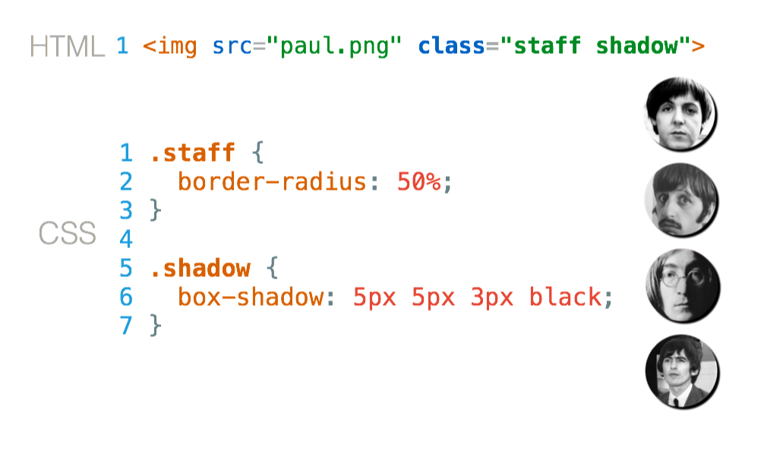
Combine

Slide 72
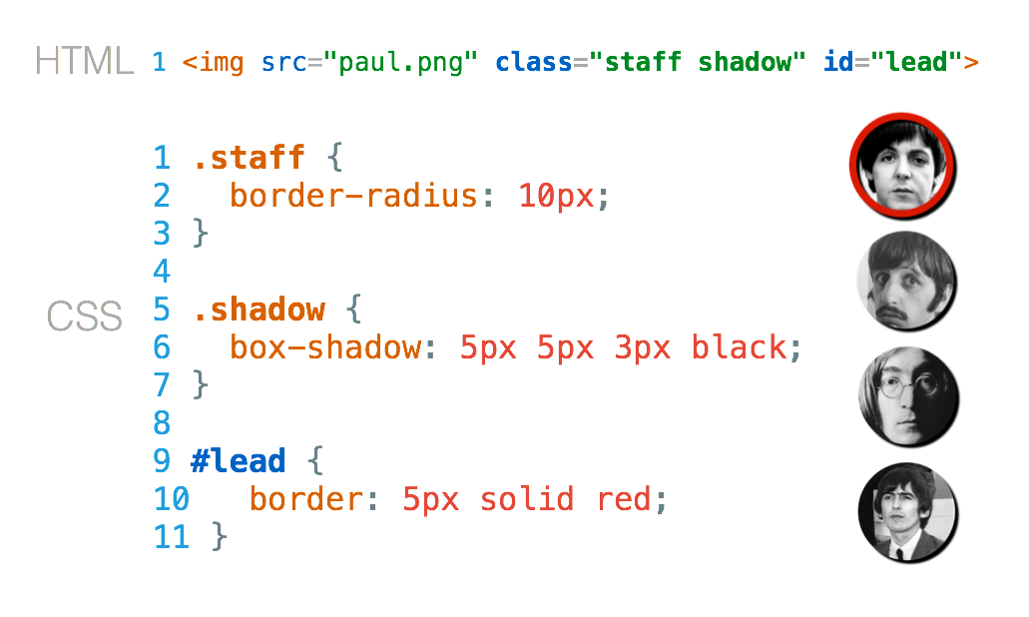
Combine

Slide 73
6. Free Code!
It’s one screen, so make it perfect
Center everything
Full screen banner
Attractive text
Great button

Slide 74
7. Free Code!
If you want to go further…
follow from #7 here to:
Make a new page
Add some pre-cooked js/wxml/wxss
Add a navigator element to link to the new page
Add a tab bar
Style the tab bar and nav bar

Slide 75

Want to go even further?
1. Want to learn more about WeChat? Check out the official WeChat documentation
2. Follow our official account for info on future workshops →
3. Apply to Le Wagon's next batch, starting June 25!! 🎊

Slide 76

Thank you!

